Slide 1
CPCS Findings
Kevin, Vedika, Sam, and PJ
Notes:
Intro

Slide 2
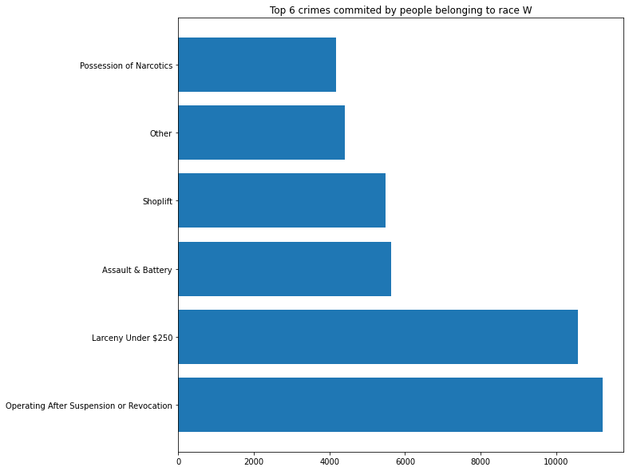
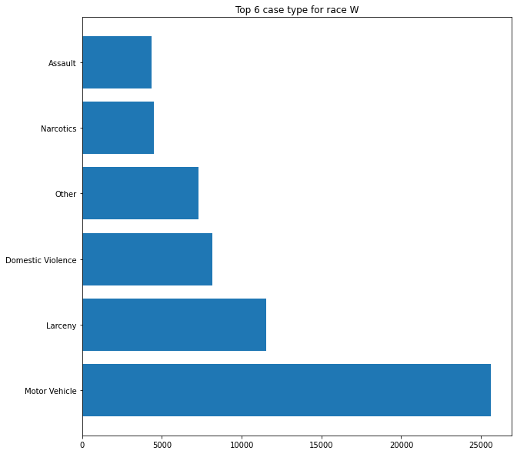
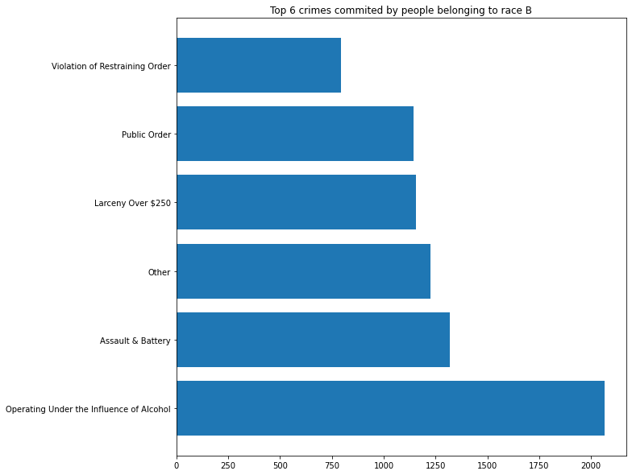
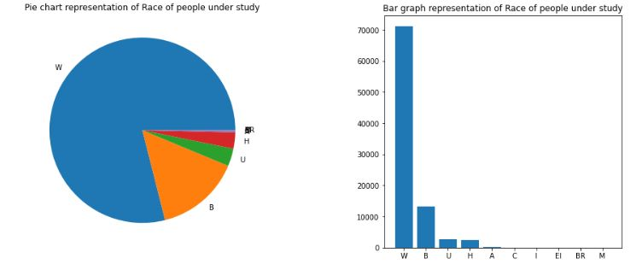
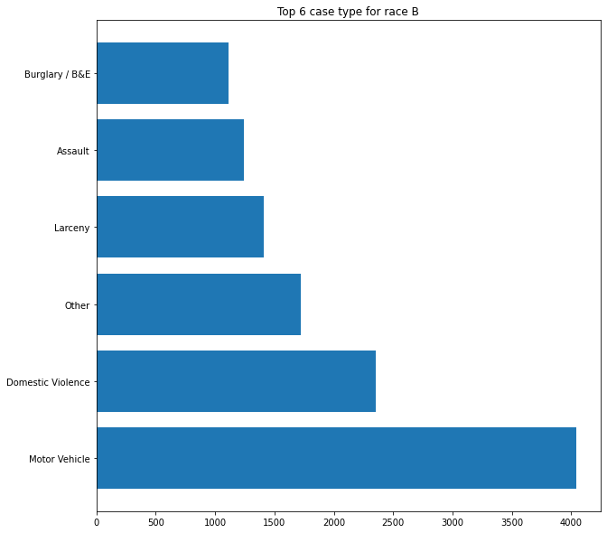
Generalized graphing and visualization

Slide 3
Questions that we asked
Is there a correlation between race and prosecution frequency
Do different groups of people have any noticeable discrepancy when committing the same crimes
Do different groups of people commit different crimes
What is size of each data set and how much data will I need to get from each one
Notes:
general(anyone)

Slide 4

Potential obstacles/limitation of the project
Being able to meaningfully quantify the groups of people who are being discriminated against
The potential inconsistency/discrepancy between the race of people vs their ethnicity

Slide 5
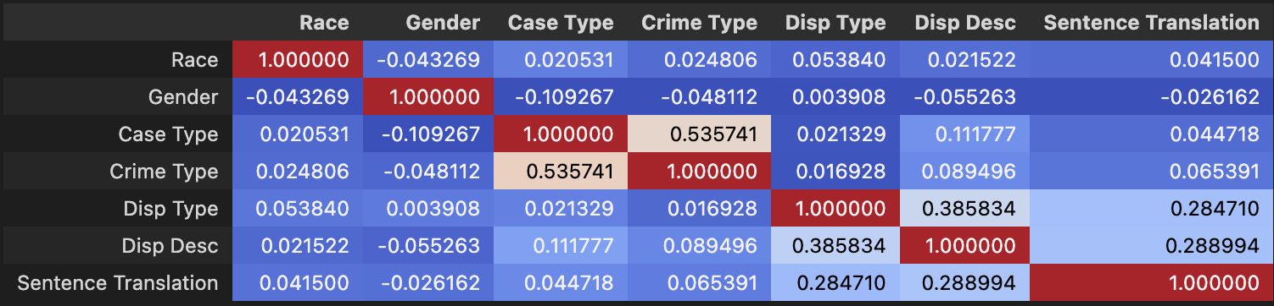
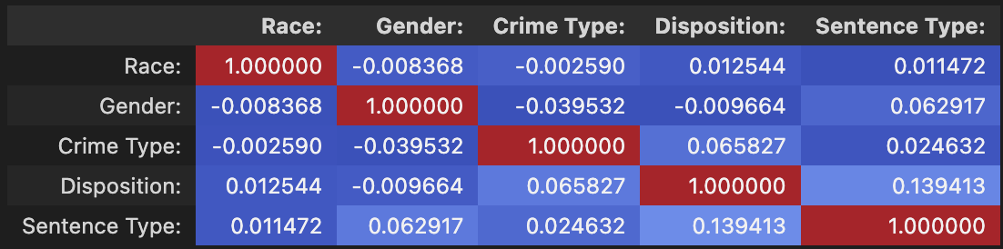
Berkshire and Northwestern Data collection
Berkshire Correlation matrix:
Which data had correlation and how could this be expanded on
What crime, dispositions, and sentences were most common among races (by percentage)
Which races had the highest percentage of which crimes
Northwestern Correlation matrix:
Notes:
PJ

Slide 6
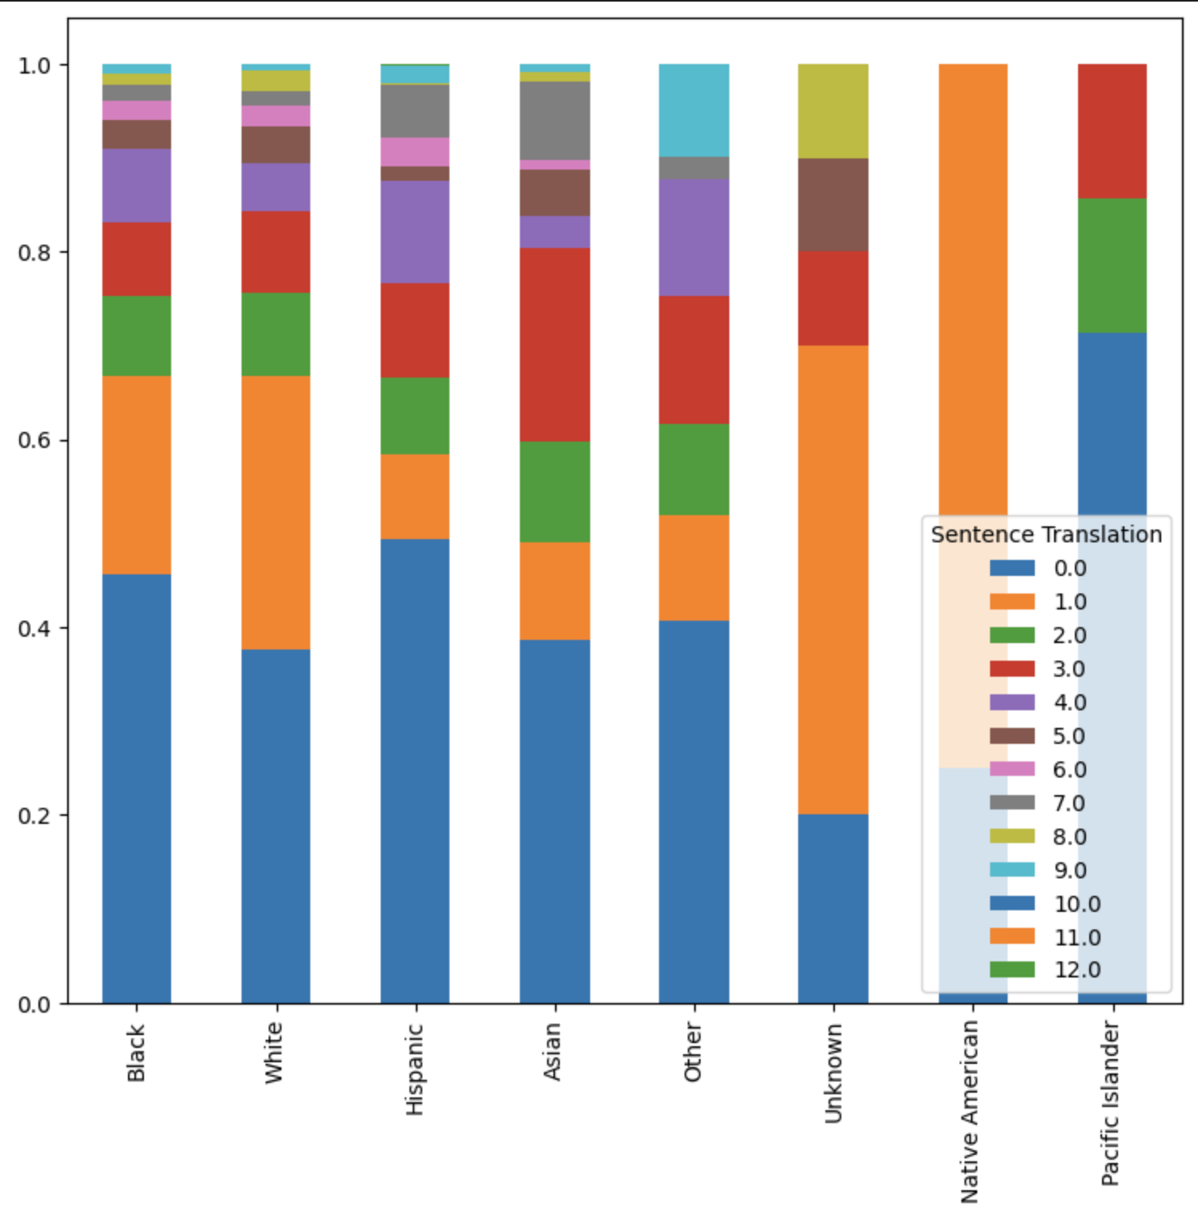
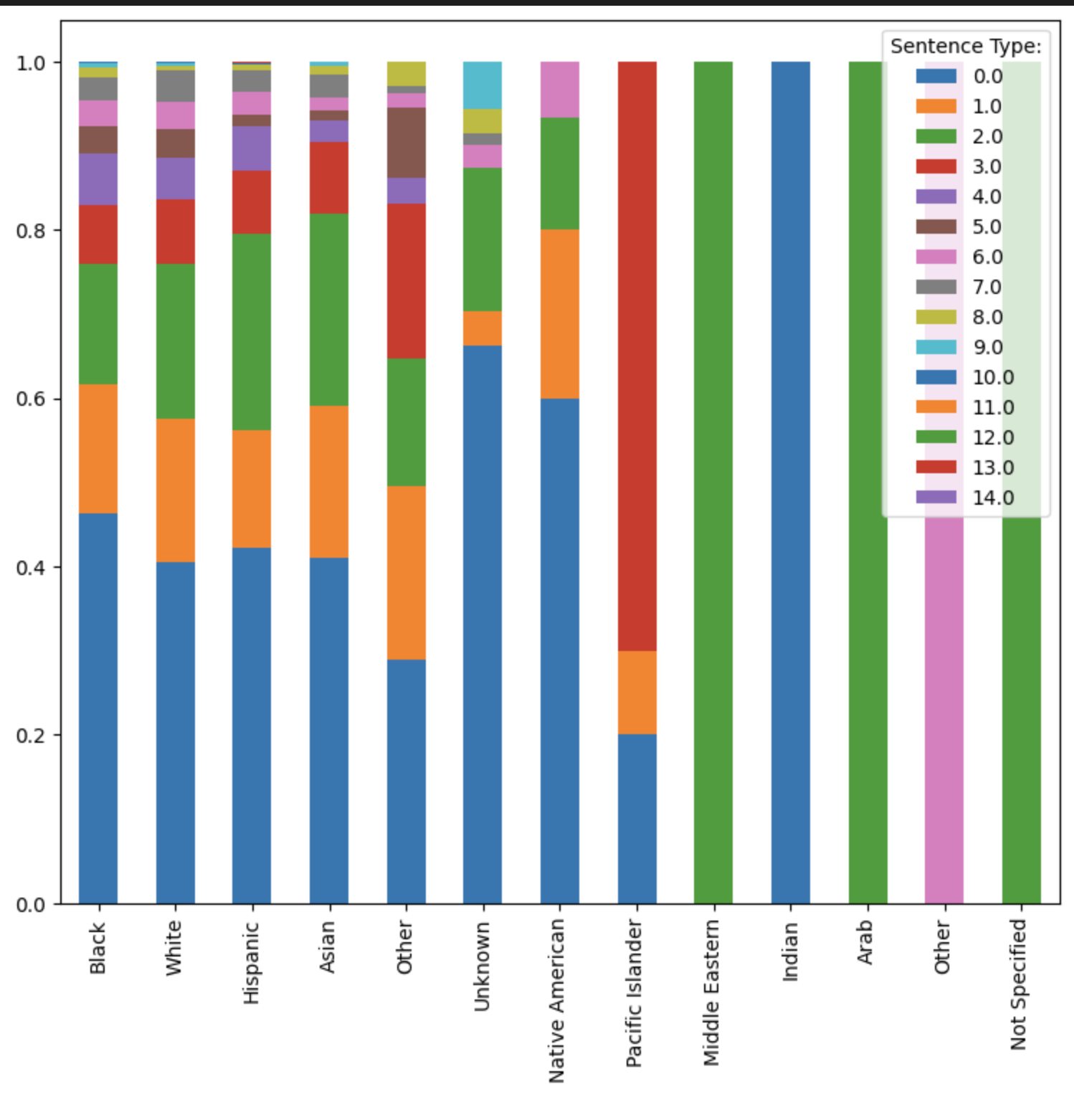
Visual Representation of Crime-Race Relation
Berkshire Bar Graph Data:
Northwestern Bar Graph Data:
Notes:
PJ

Slide 7
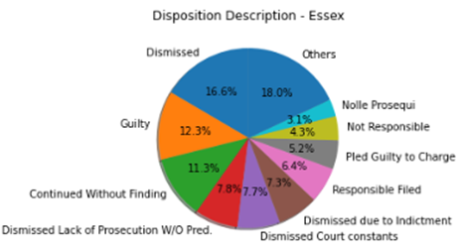
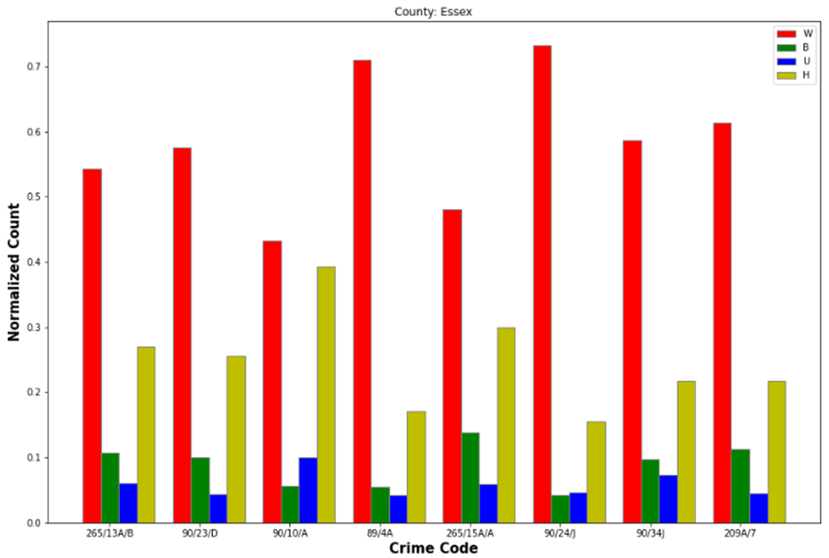
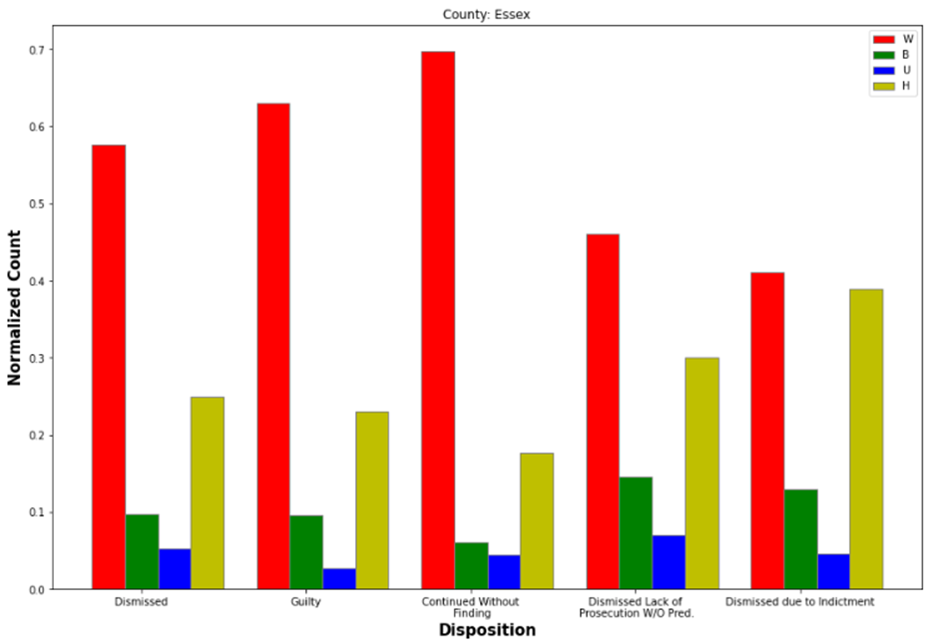
Essex Data Insights
Notes:
Vedika

Slide 8
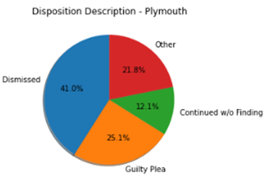
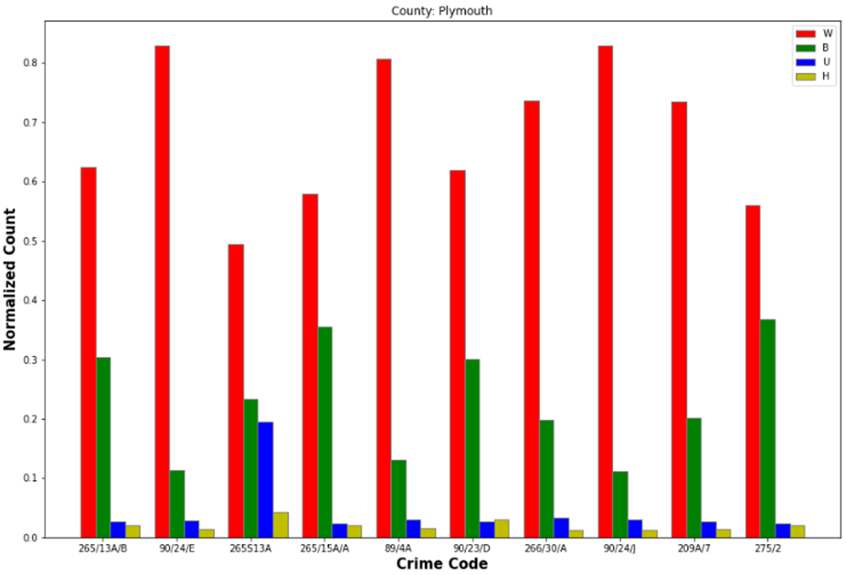
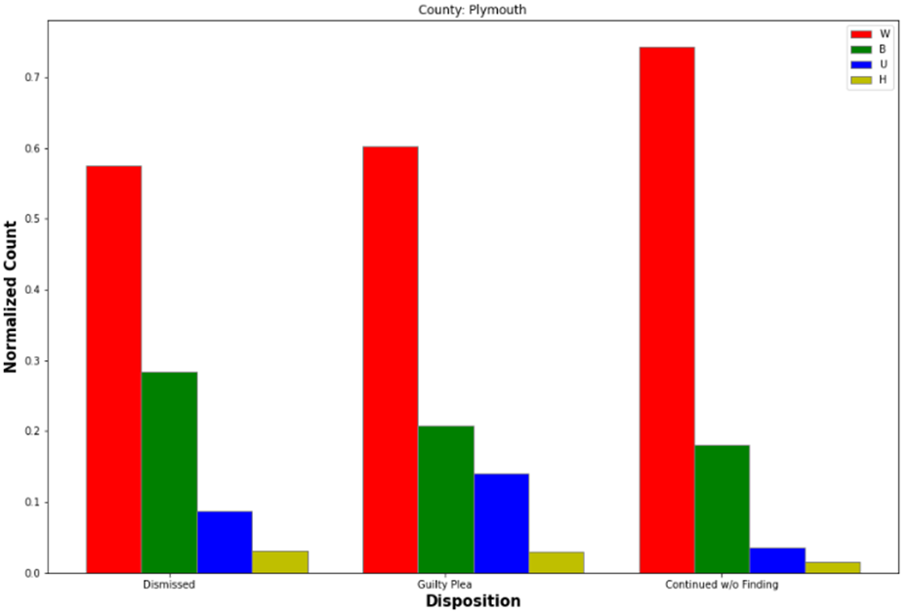
Plymouth Data Insights
Notes:
Vedika

Slide 9
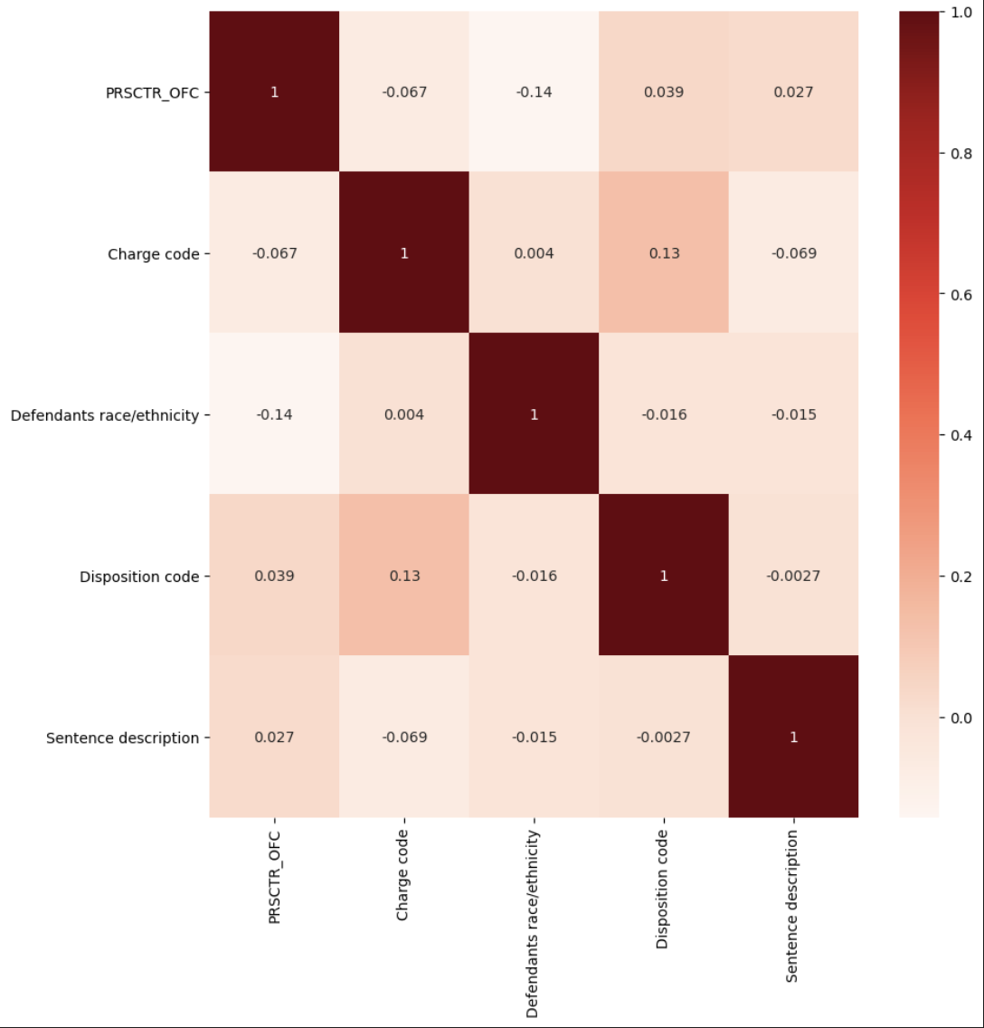
Worcester
Heatmap showing correlation between the features
Most significant correlations with Defendant’s race/ethnicity
Disposition Code
Sentence Description
Notes:
Sam Shih

Slide 10
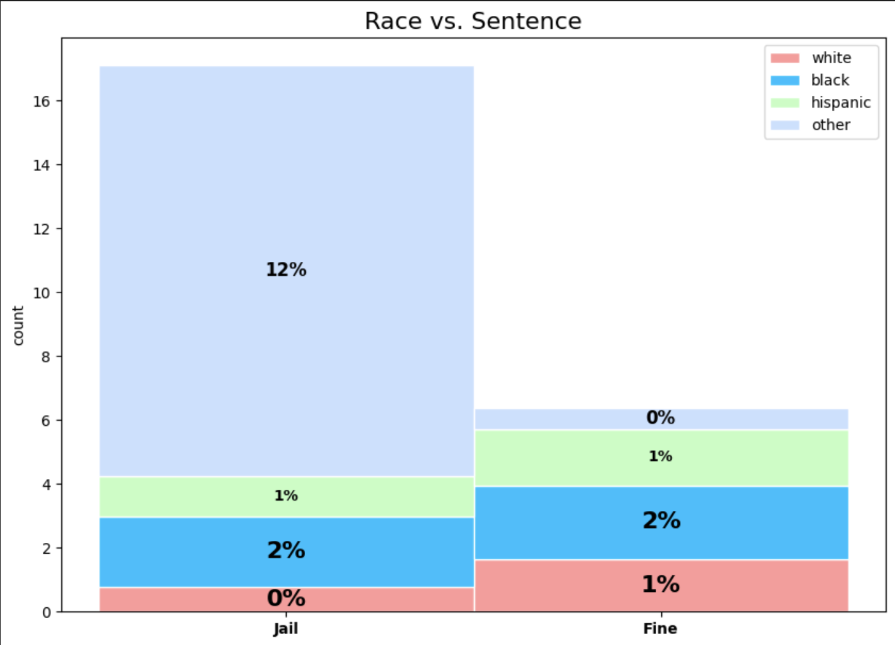
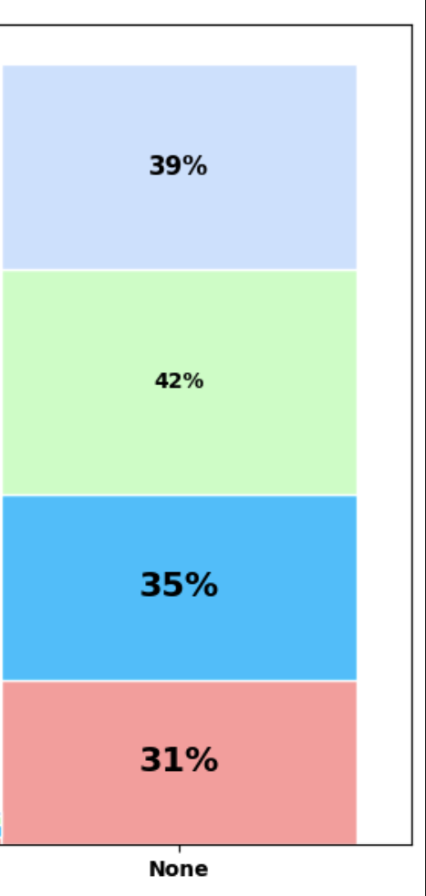
Worcester:
DRUG, POSSESS CLASS B c94C ?34

Slide 11
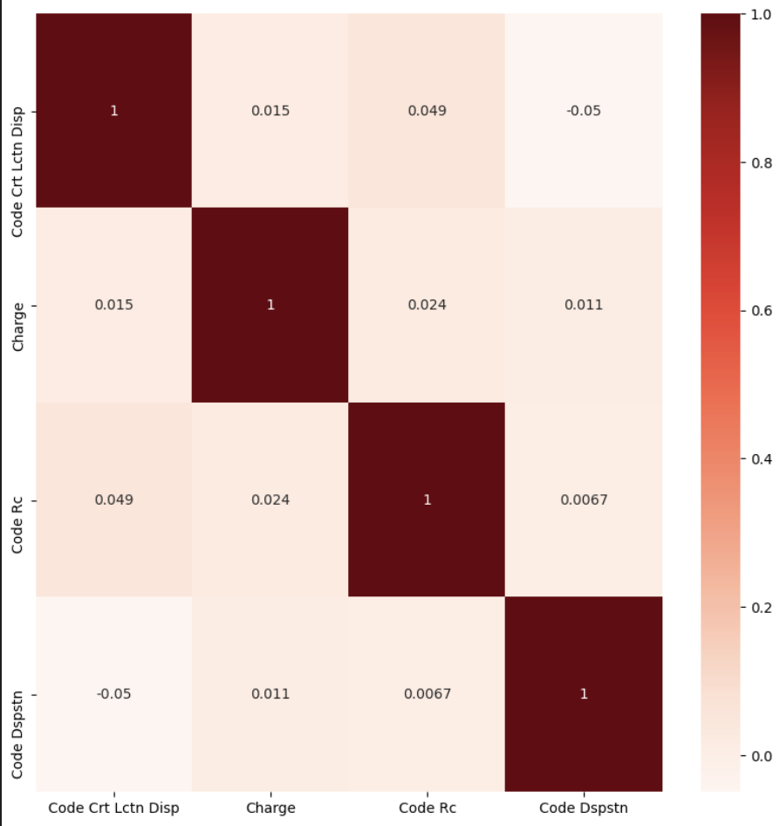
Norfolk
Heatmap showing correlation between the features
Most significant correlations with Defendant’s Race (Code Rc)
Court Location (Code Crt Lctn Disp)
Charge
Notes:
Sam Shih

Slide 12
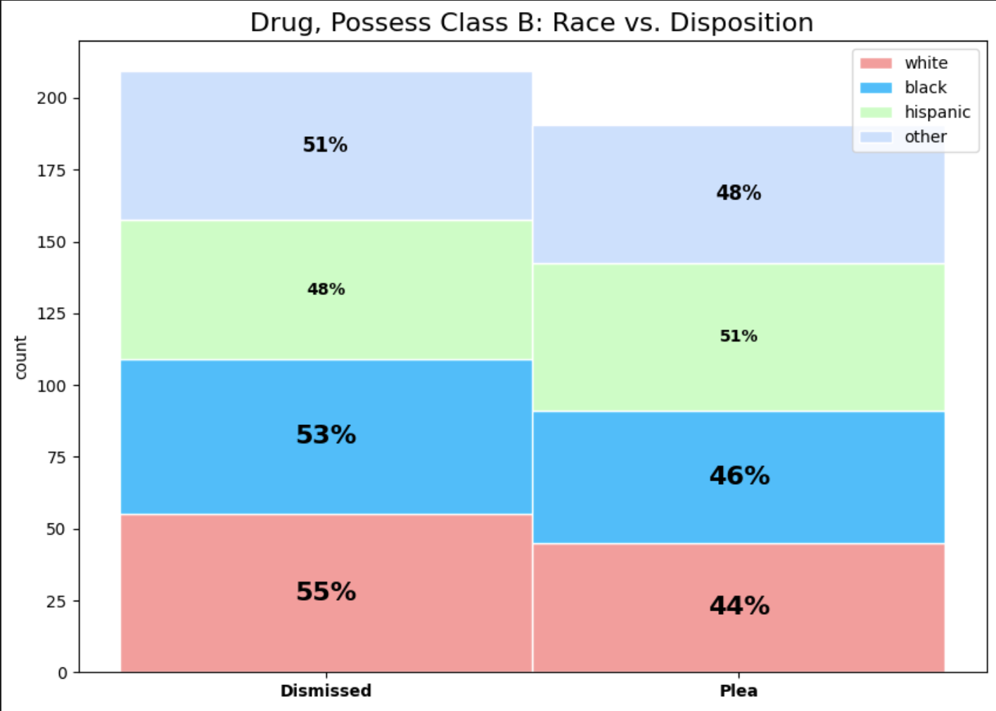
Norfolk:
DRUG, POSSESS CLASS B c94C ?34

Slide 13
Thank you

